Slide 1

Naïve bays lab
Qinyi Liu
IGSIN 919

Slide 2
The process of it
Install the necessary libraries
Read a csv file and explore the data
Train and test data
Create a naïvebayes model
Make predictions on the test dataset
Check the accuracy of our model

Slide 3
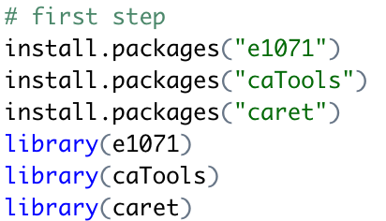
1. Install the necessary libraries

Slide 4
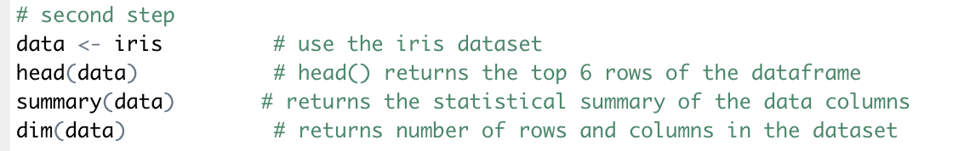
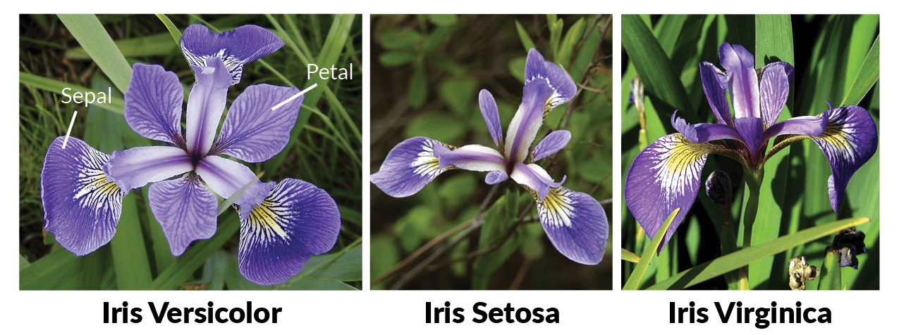
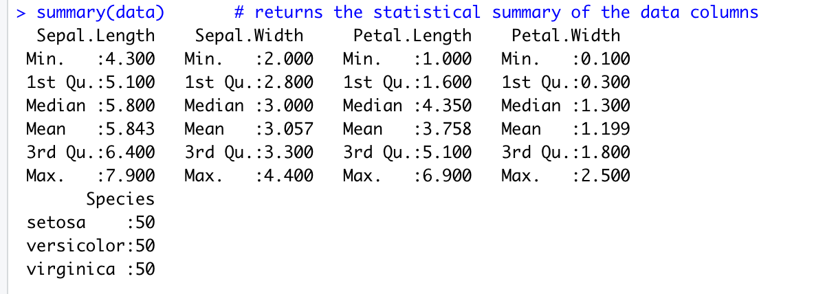
Explore the data
Picture sources here

Slide 5
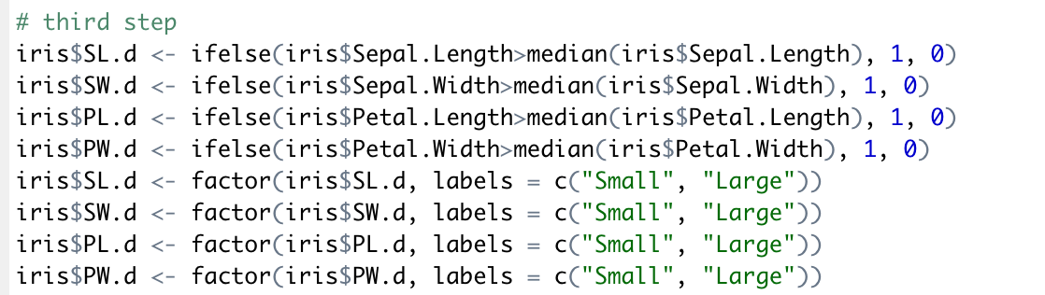
Train and test data

Slide 6
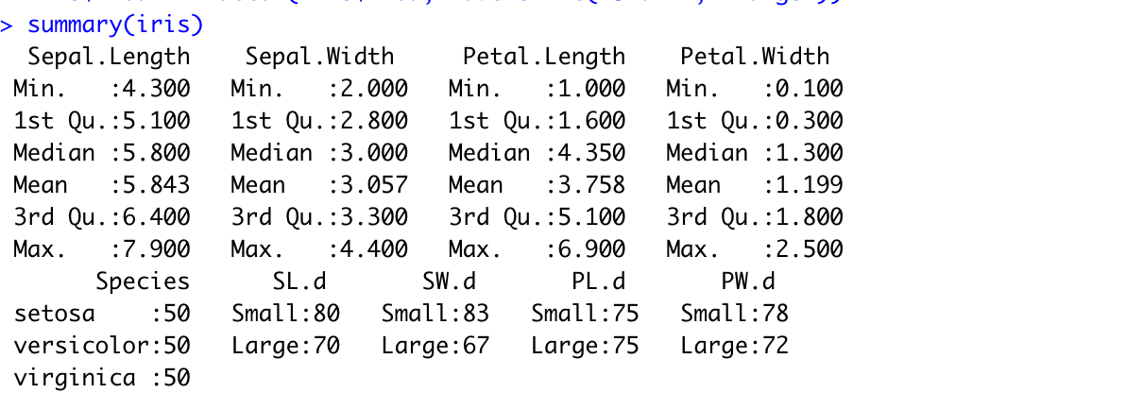
Train and test data

Slide 7
Lab 1
Download the dataset called.. From mittuib, download the r file from mittuib
Import and explore the dataset. Remember, variable “Outcome” is our Y
Transform the variable “Outcome” to a factor and give it two levels called “health” and “ill”
Transform all the ‘0’ values from 2nd columns to 7th columns to NA

Slide 8
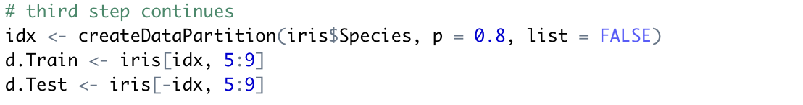
Create a naïve bayes model

Slide 9
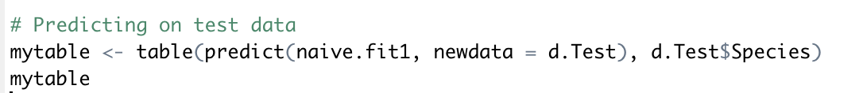
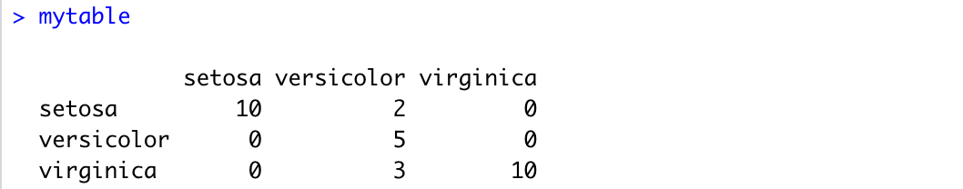
Make predictions

Slide 10
Check the accuracy

Slide 11
cross validation
Why cross validation?
1. Cross-validation is used to assess the predictive performance of a model, particularly the performance of a trained model on new data, and can reduce overfitting to a certain extent.
2. It also allows to obtain as much valid information as possible from a limited amount of data.

Slide 12
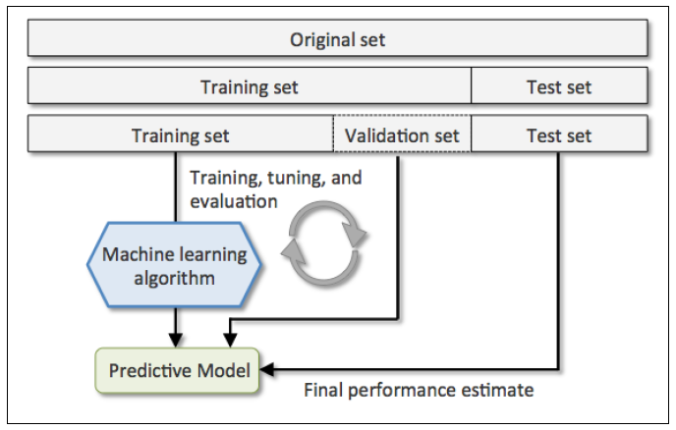
cross validation
holdout cross validation
Picture resources

Slide 13
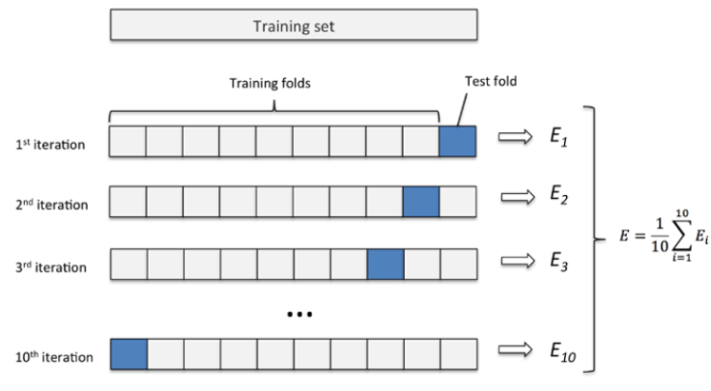
K-fold cross validation
k-fold cross-validation reduces the variance by averaging the results of training over k different subgroups, so that the performance of the model is less sensitive to the division of the data
Picture resources

Slide 14
K-fold cross validation
the original data are randomly divided into k copies without repeated sampling
1 copy is selected each time as the test set and the remaining k-1 copies are used as the training set for model training
the second step is repeated k times, so that each subset has one chance to be used as the test set and the rest as the training set. After training on each training set a model is obtained.
the average of the k sets of test results is calculated as an estimate of the model accuracy and used as the performance metric for the model under the current k-fold cross-validation

Slide 15
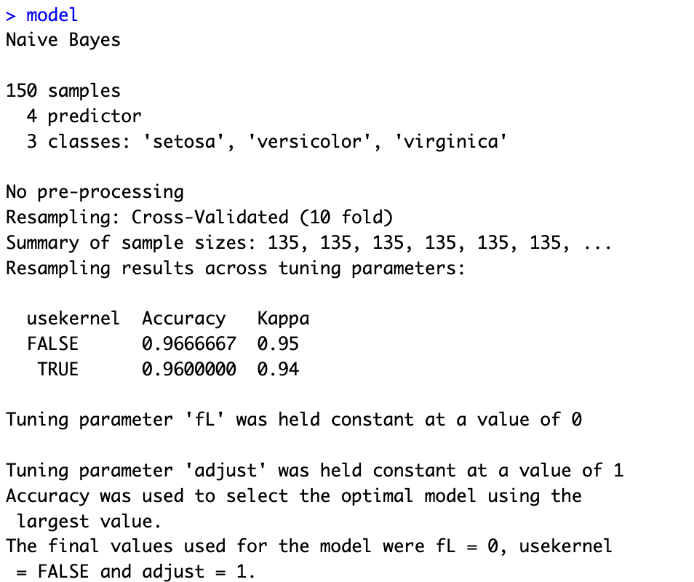
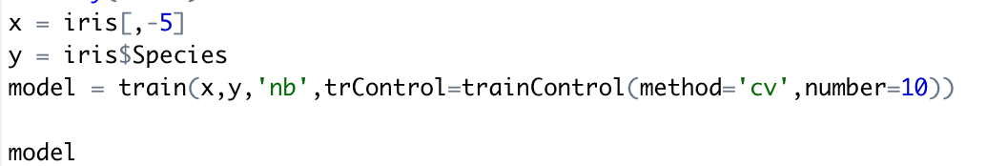
Naïve bayes with 10-fold cv

Slide 16
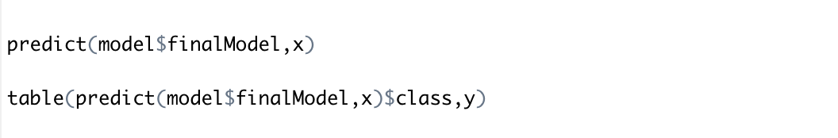
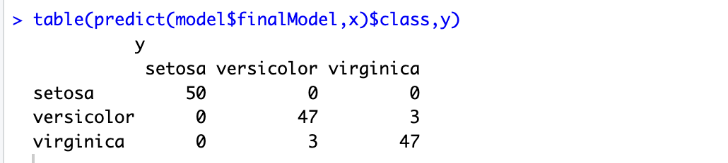
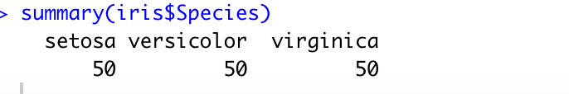
Naïve bayes with 10-fold cv

Slide 17
Lab 2
Train your naïve bayes model with split rate of 0.75 for the train dataset and test dataset, using the 10-fold cross validation

Slide 18
reference
Dataset used: https://www.kaggle.com/datasets/johndasilva/diabetes?resource=download

